Slide 1
Development of an Eco-Friendly, Autonomous Beach-Cleaning Robot
Team C.C
Eunmin Kim, Jeeyoung Oh, Booyong Kim, Seoyeong Lee, Hanbyeol Lee, Caleb Ikalina
Dankook Univ., Chung-ang Univ., Sangmyung Univ., Daegu Catholic Univ., Chung-ang Univ., Purdue Univ.

Slide 2

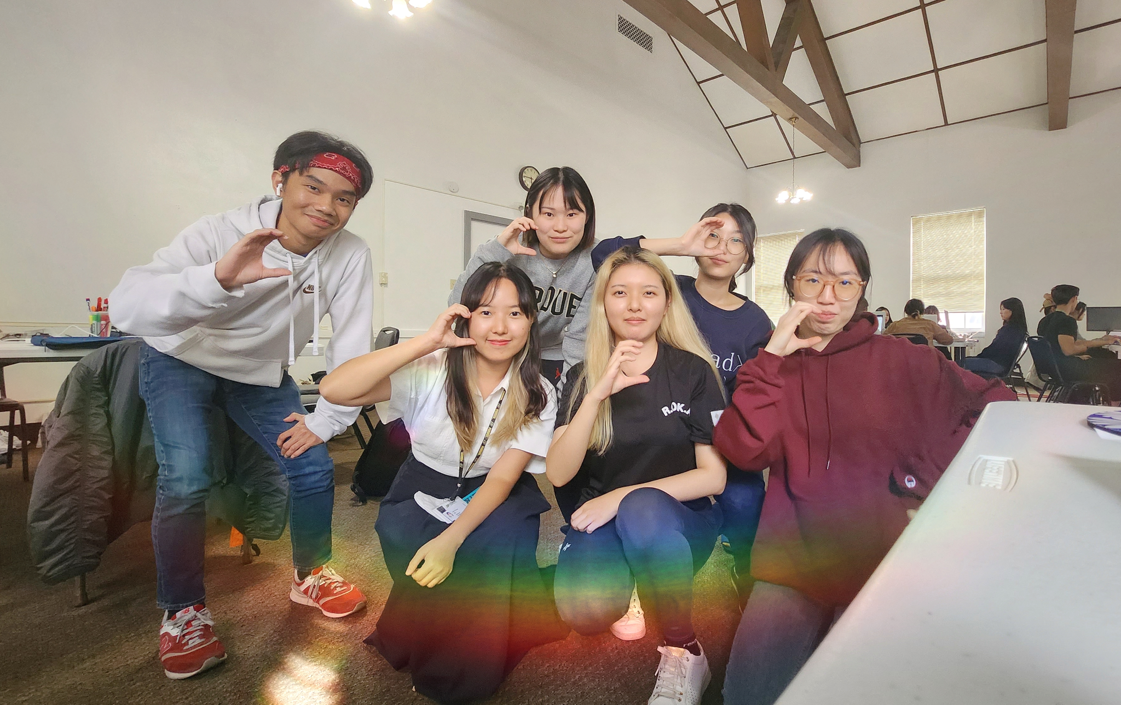


Team C.C
Eunmin Kim
Dankook Univ.
Seoyeong Lee
Daegu Catholic Univ.
Hanbyeol Lee
Chung-ang Univ.
Team C.C
Jeeyoung Oh
Chung-ang Univ.
Booyong Kim
Sangmyung Univ.
Caleb Ikalina
Purdue Univ.
2

Slide 3
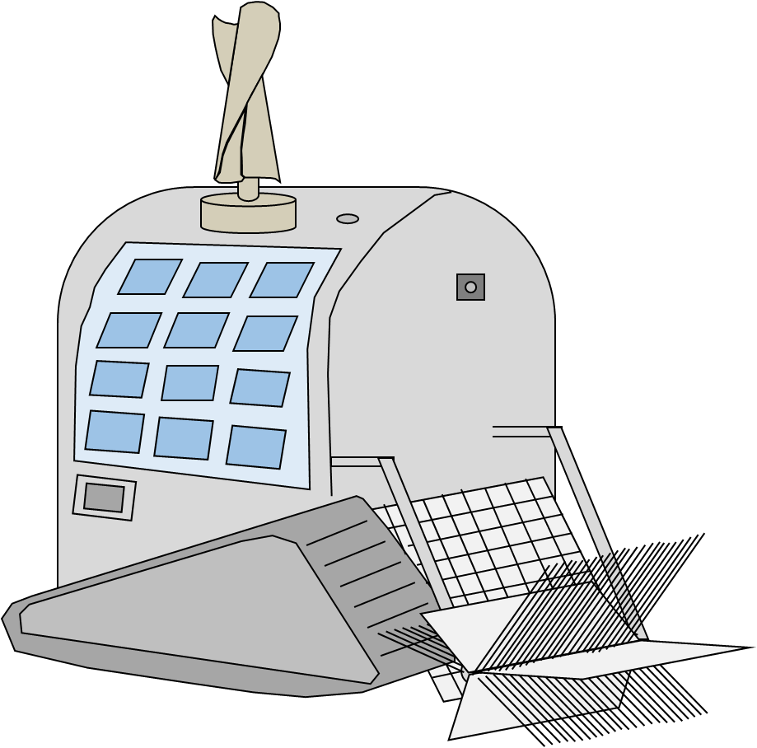
Contents
1. Problem Statements
2. Literature review
3. Novelty
4. ABCbot structure – physical, vision
5. Challenges and expectations
6. Future Plan

Slide 4
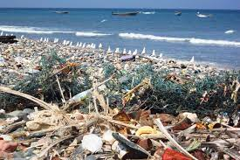
Problem Statement
Current state of affairs
Around 710 million metrics tons of plastic ^{[1]}
Get injured such as bare feet ^{[2]}
Slowdown at local economy ^{[3]}

Slide 5
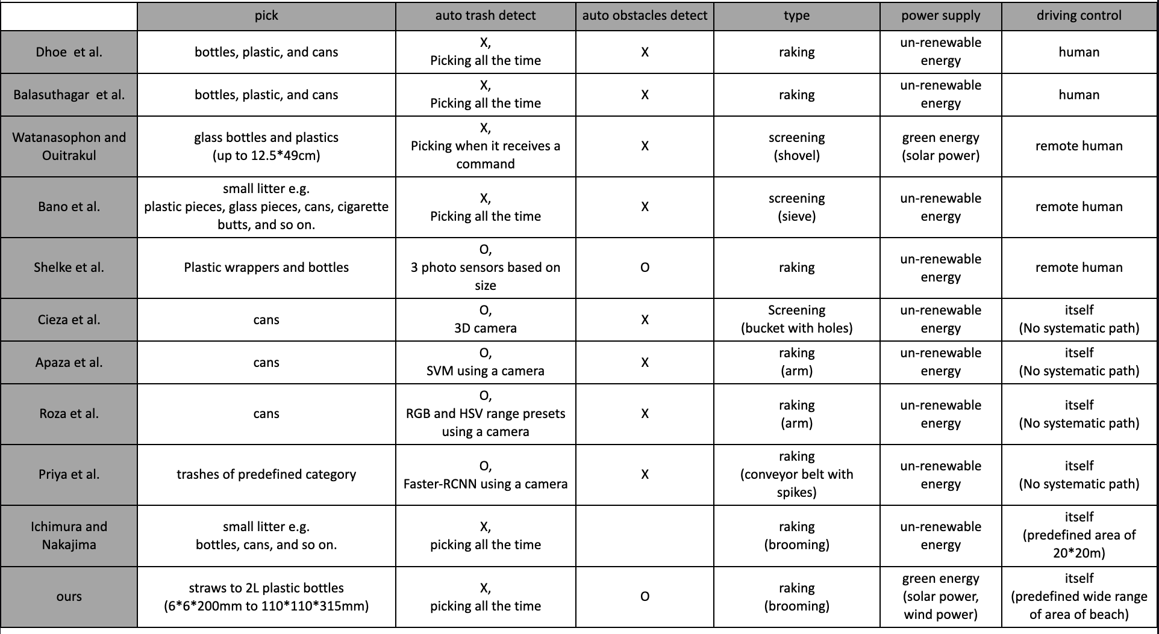

Literature Review ^{[4]-[18]}

Slide 6





Novelty
Autonomous Drive, GPS
Eco-friendly
Computer Vision
“Autonomous Beach Cleaning roBot”

Slide 7
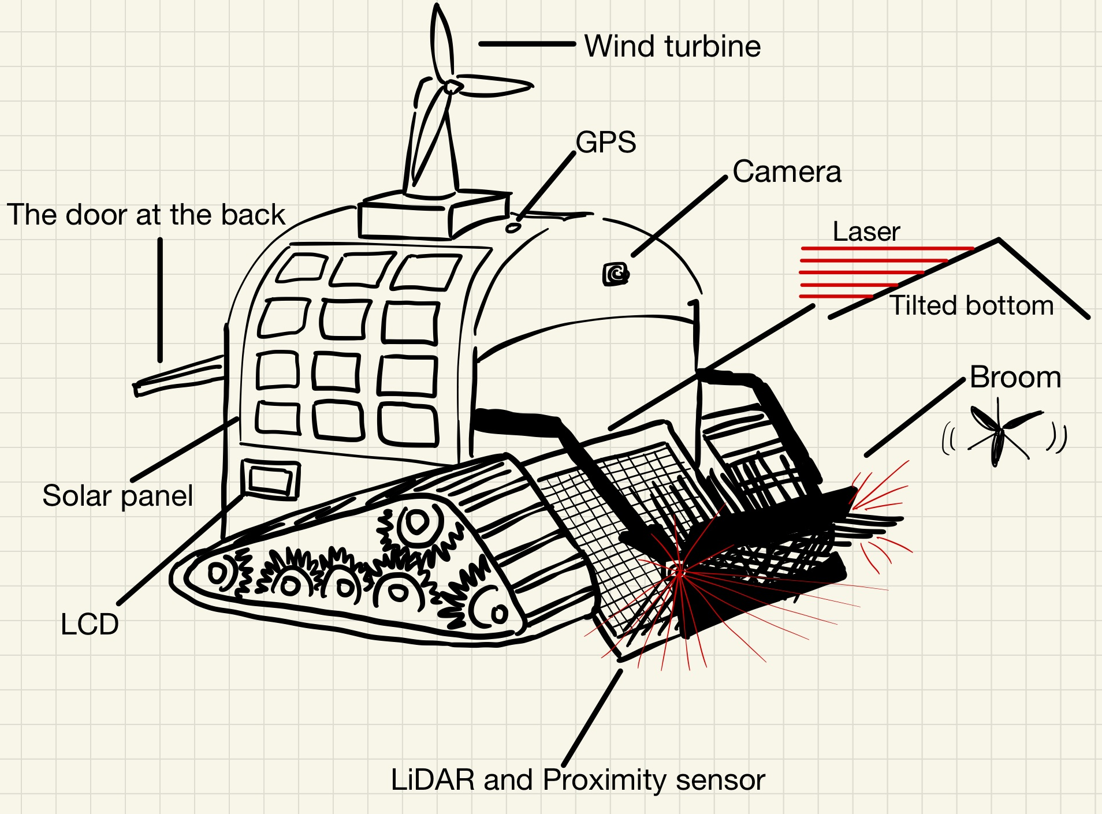
ABCbot Structure

Slide 8
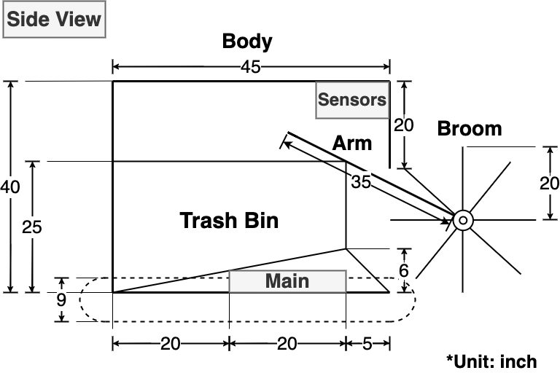
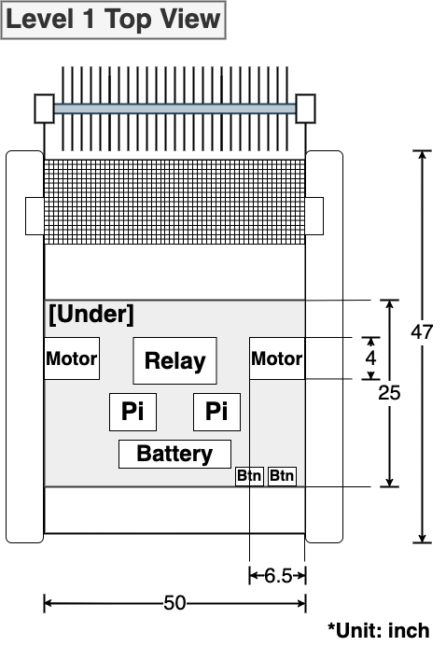
Robot platform
Level 1 Top View
Side View

Slide 9
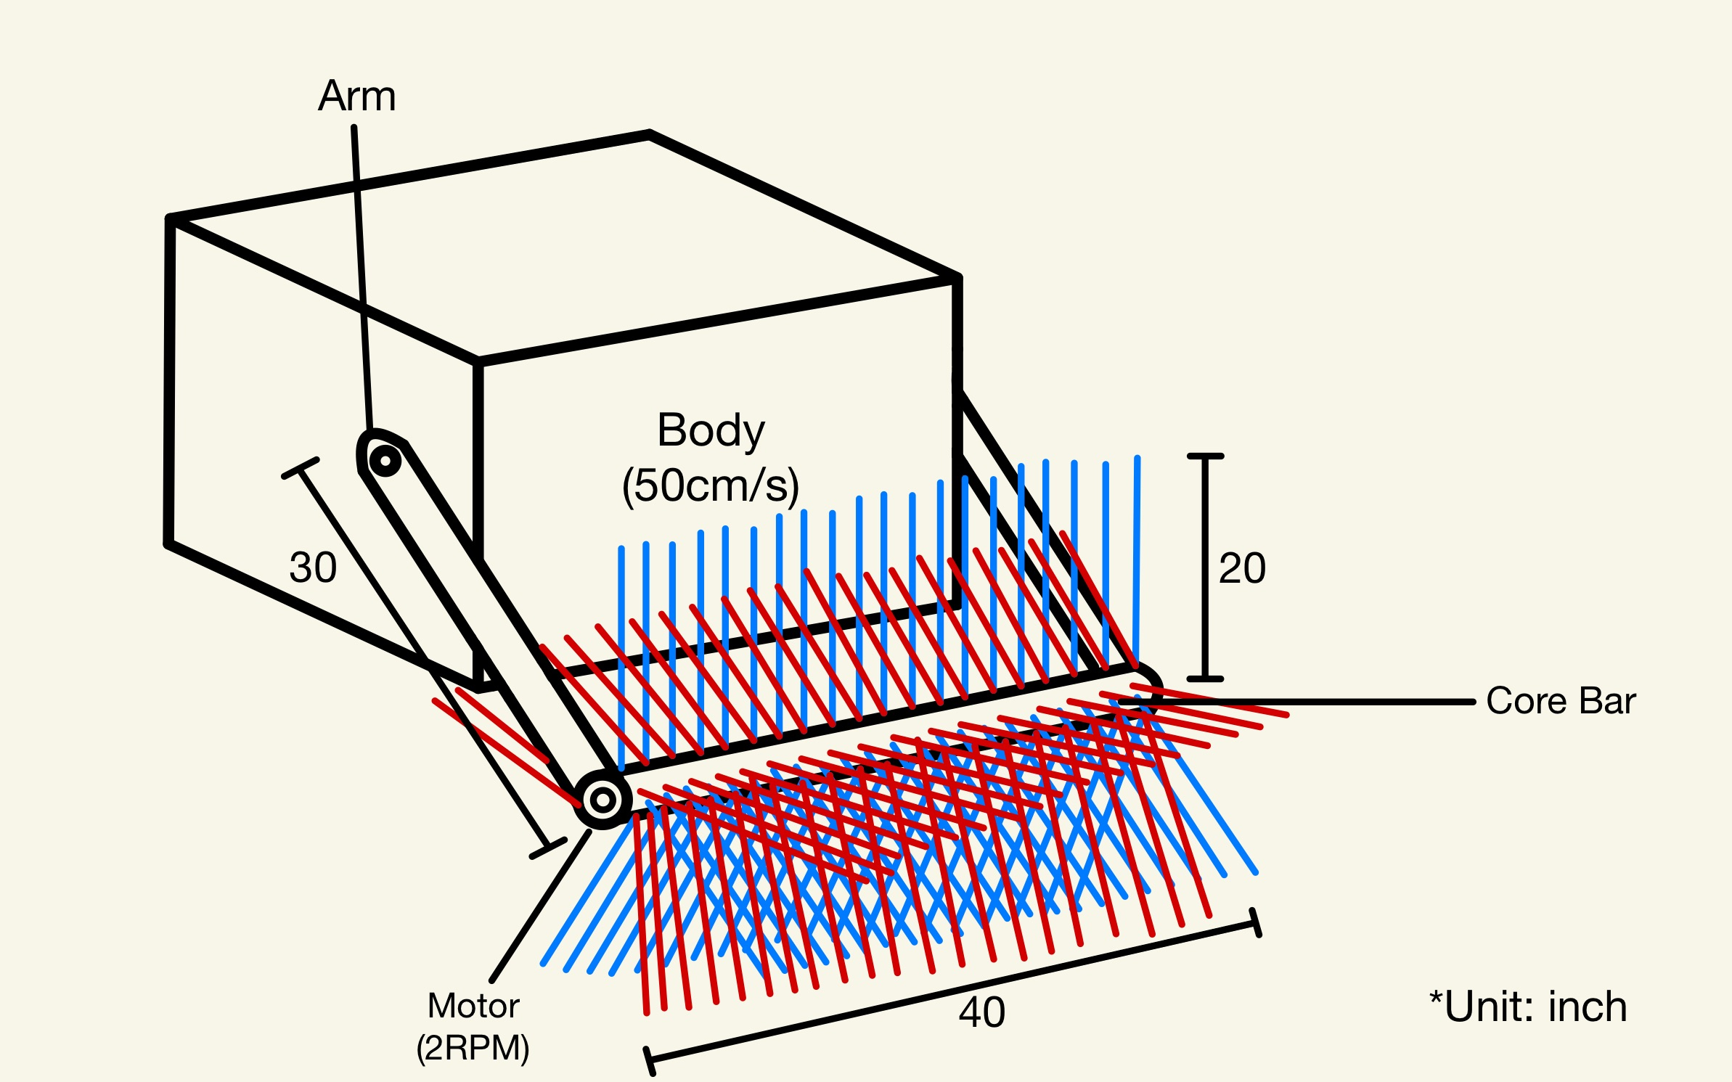
Broom

Slide 10
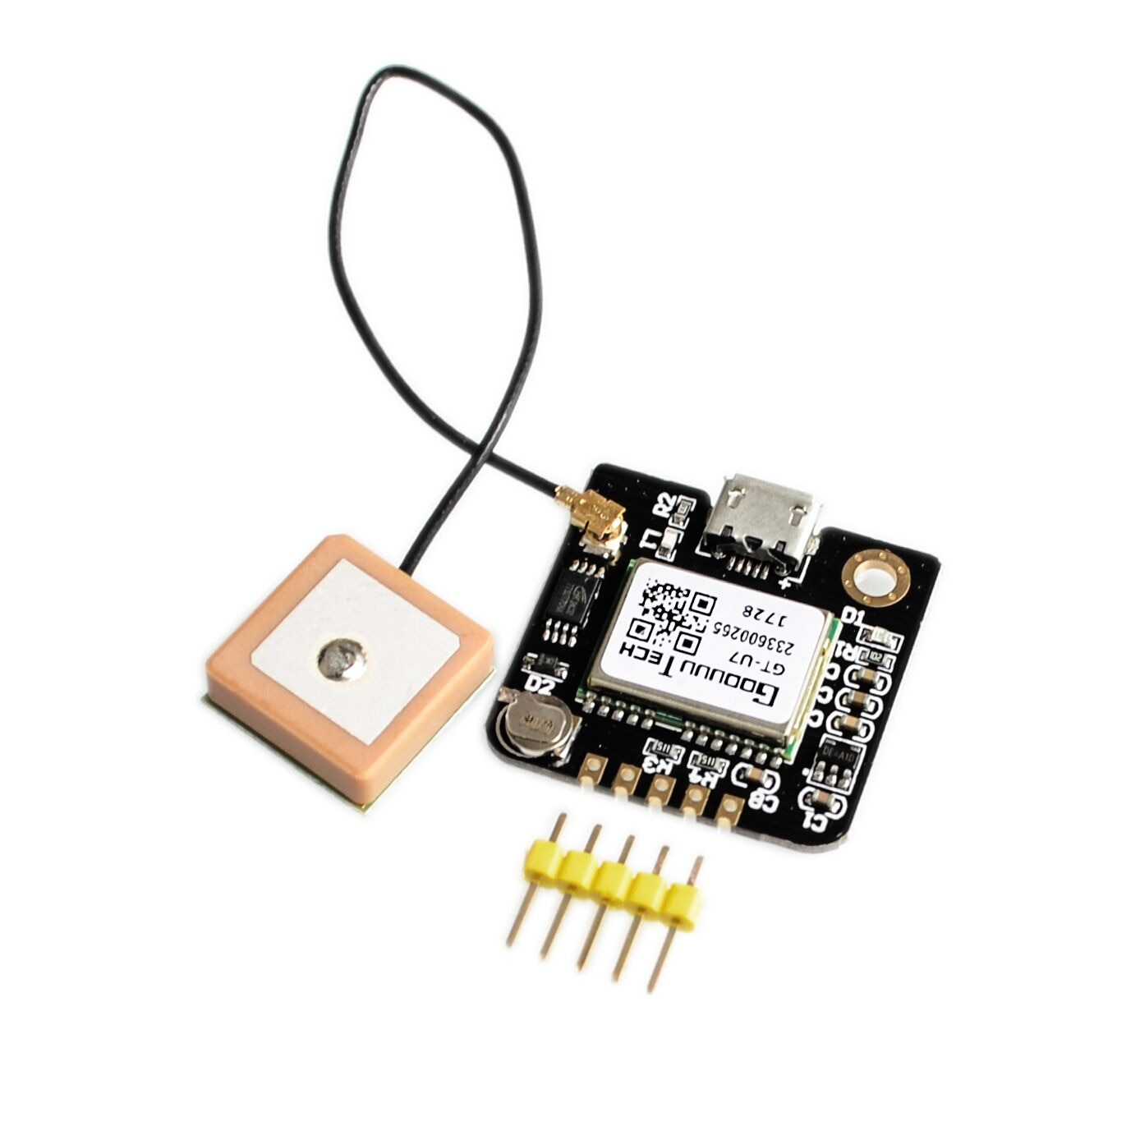
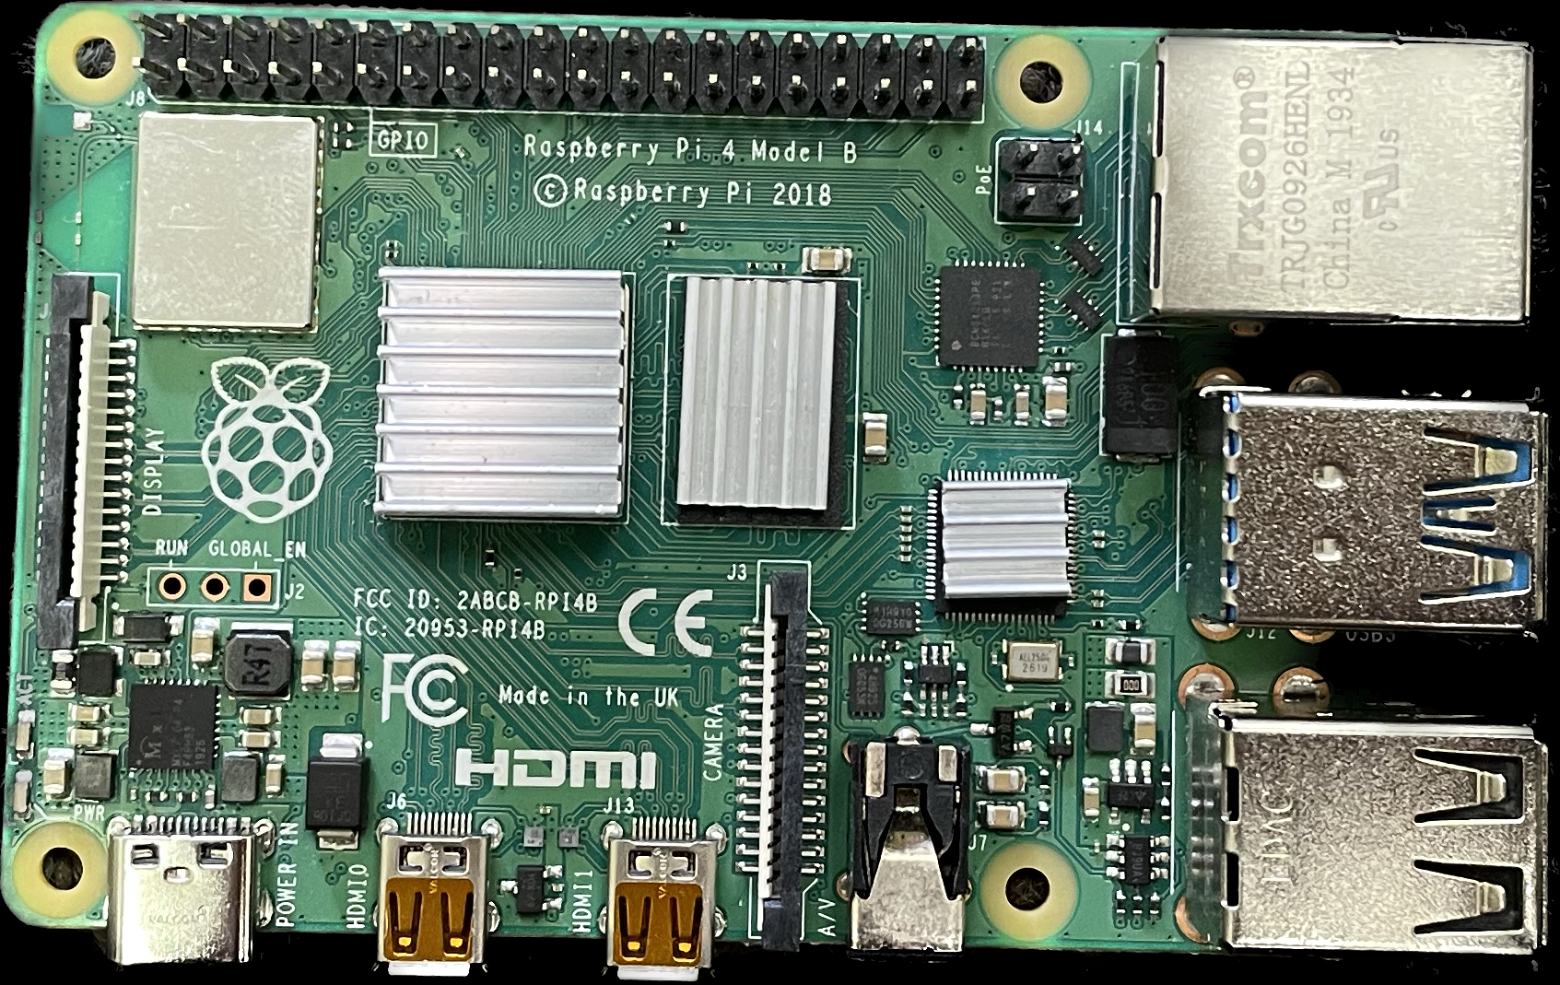
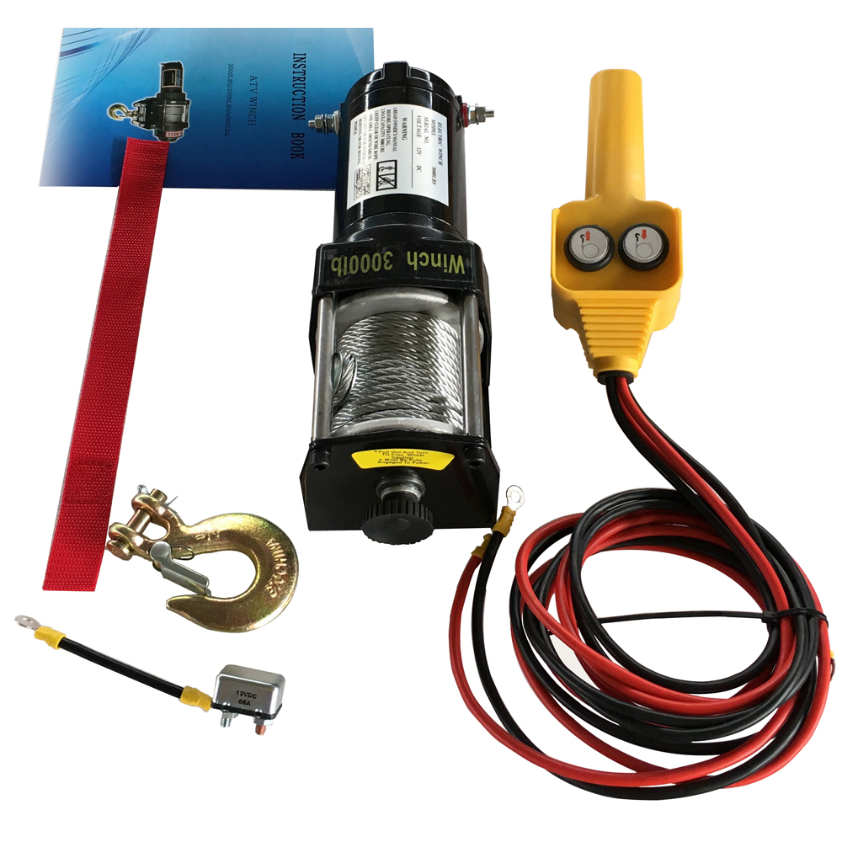
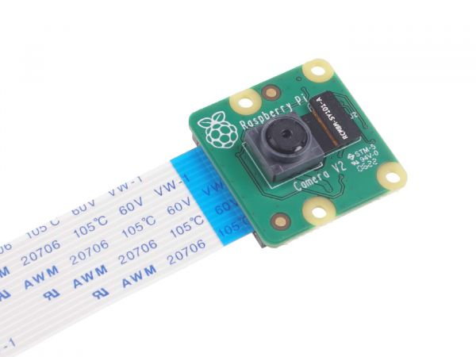
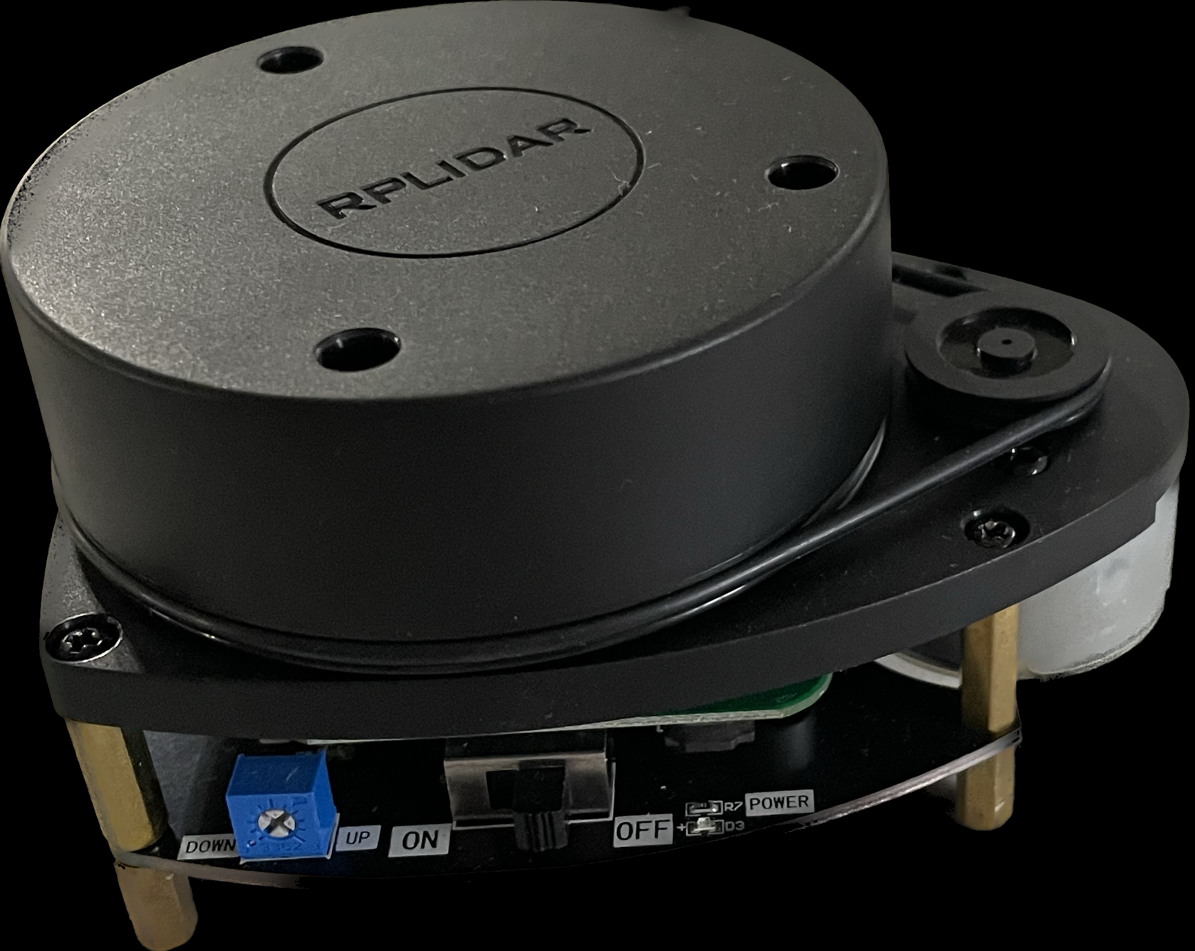
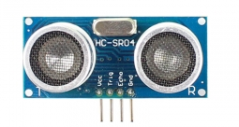
Physical Part
Robot platform
12V Bad Land motor
RPi 4 model B+
NEO-6M GPS(GT-U7)
2D RP LiDAR A1
Pi Cam
Proximity sensor

Slide 11
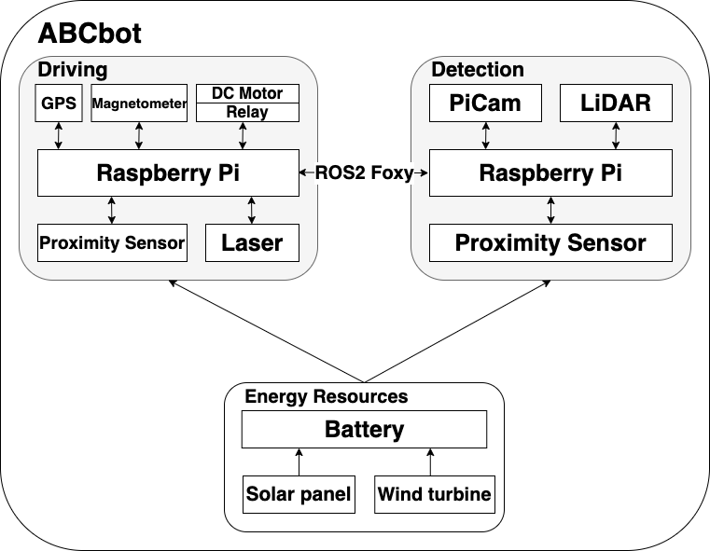
ABCbot Structure
Ubuntu
20.04.5

Slide 12
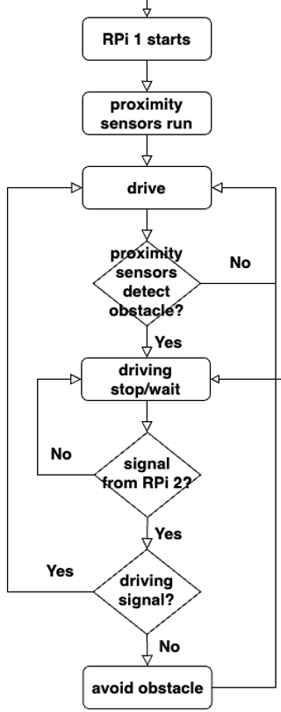
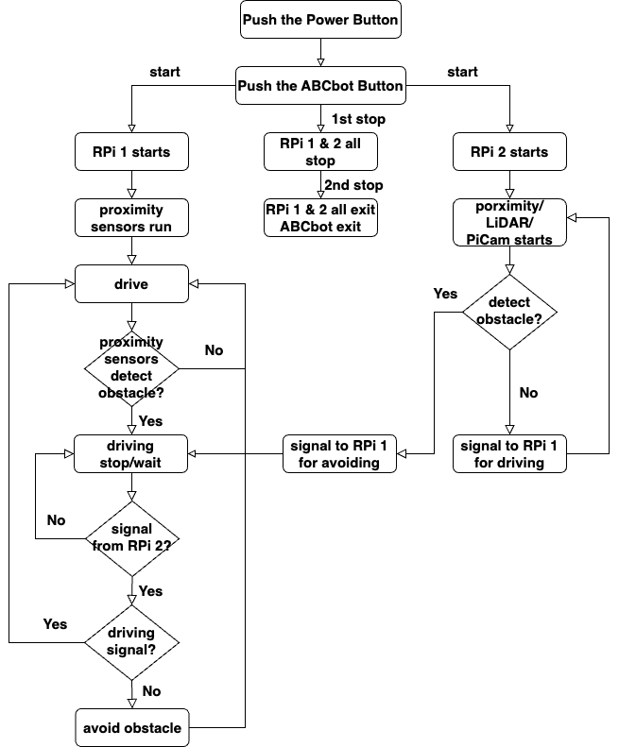
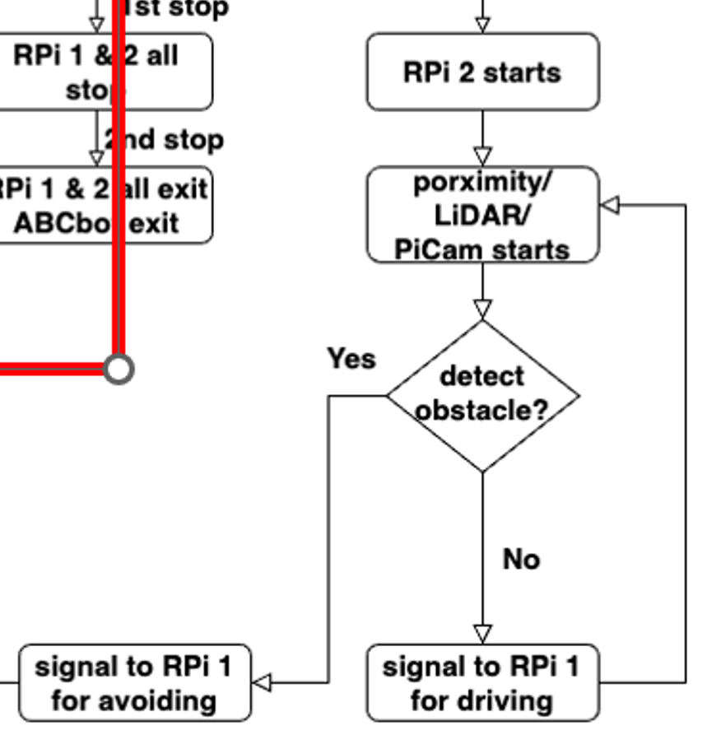
Control Flow

Slide 13
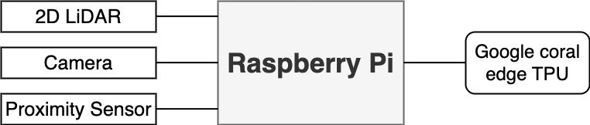
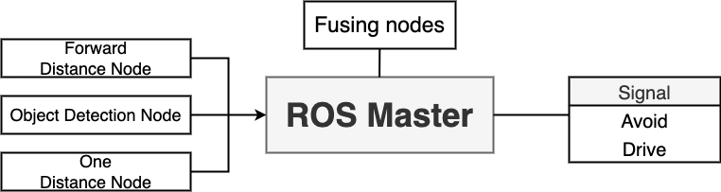
Vision Part
Detection
Pi Structure
Ros Structure

Slide 14
Rating Scale
Criteria
Energy effectiveness – picking up the trash & disposing of the trash
Communication effectiveness - how to communicate
How well ABCbot can pick up the trash

Slide 15
Challenges
Physical Part
Achieve the most efficient trash-picking performance
Control motors accurately
Avoid obstacles in a feasible time

Slide 16
Challenges
Computer Vision Part
The robot cannot be operated properly
Controlling the robot while many sensors
are communicating

Slide 17
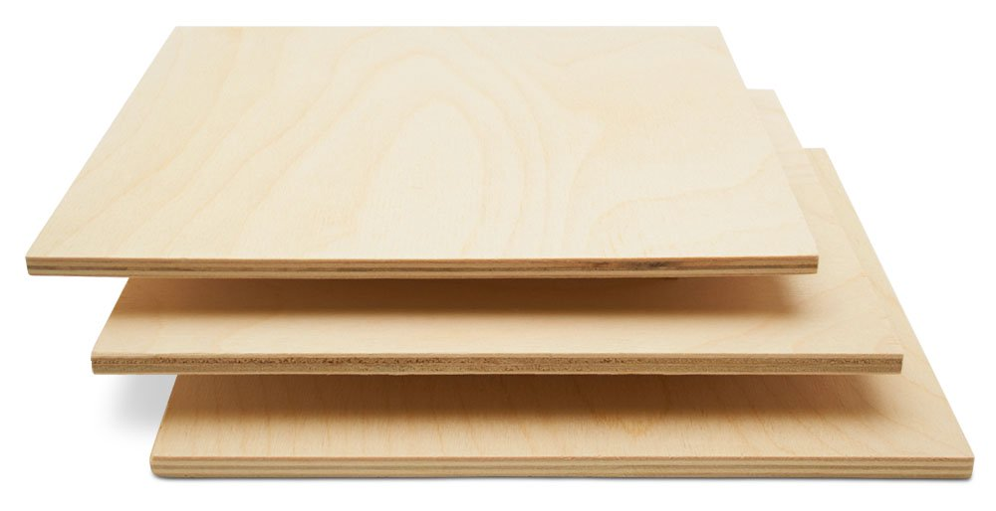
Testing Environment
Indoor test
60 * 300 inch
Plywood
Sand

Slide 18
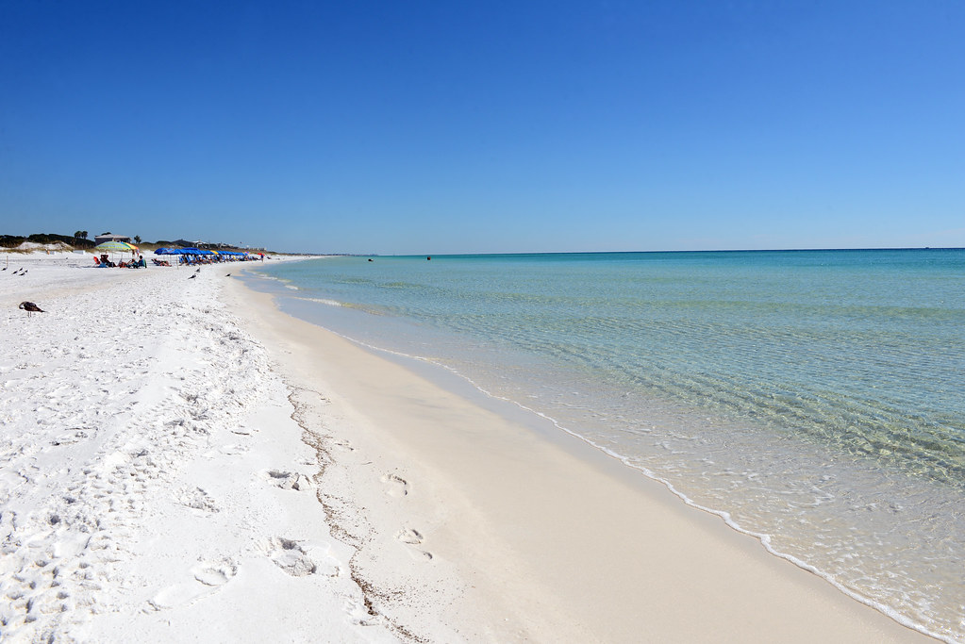
Expectation
Available plan
Doing demonstrations outdoor
Leads to other research

Slide 19
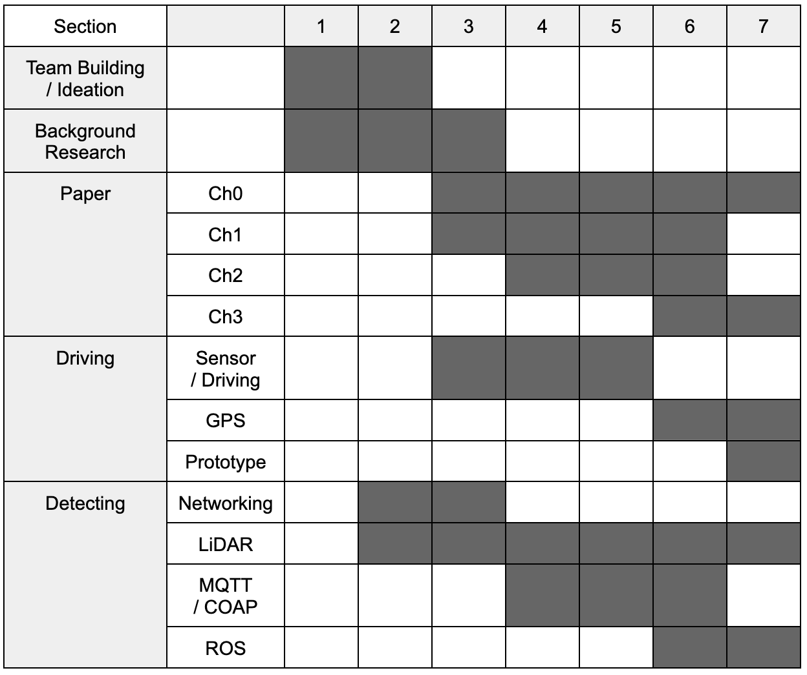
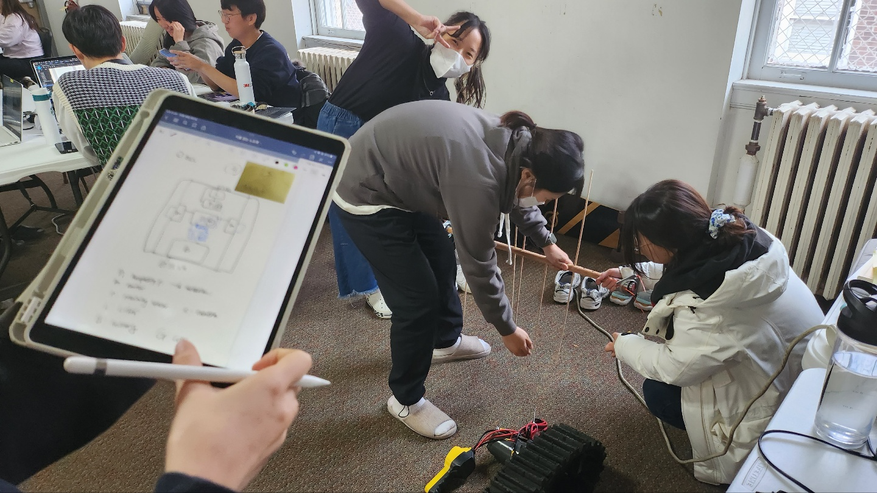
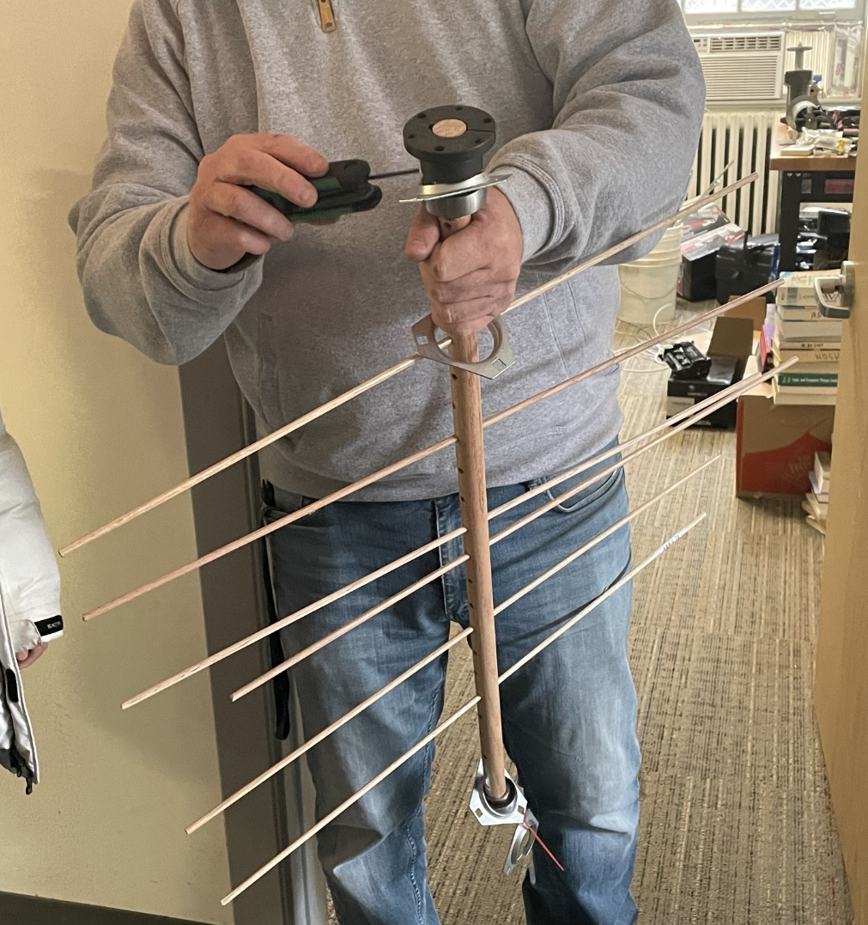
Current status
Research progress
Complete the design – platform , broom
Making a prototype

Slide 20
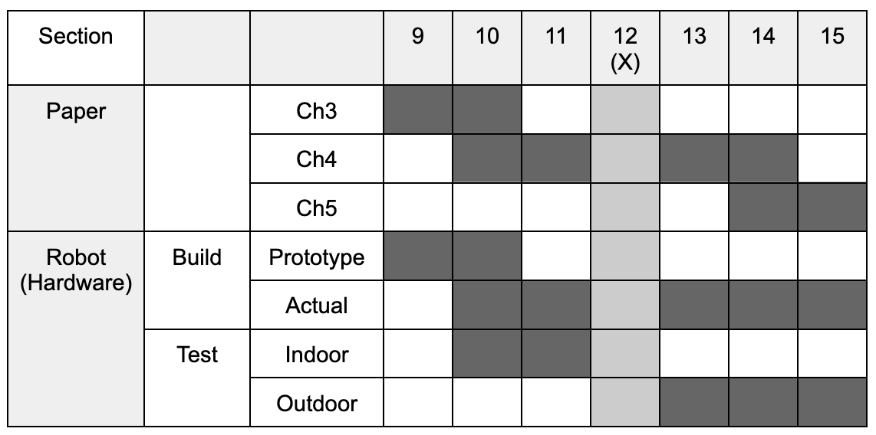
Future Plan
Paper, Robot (HW)

Slide 21
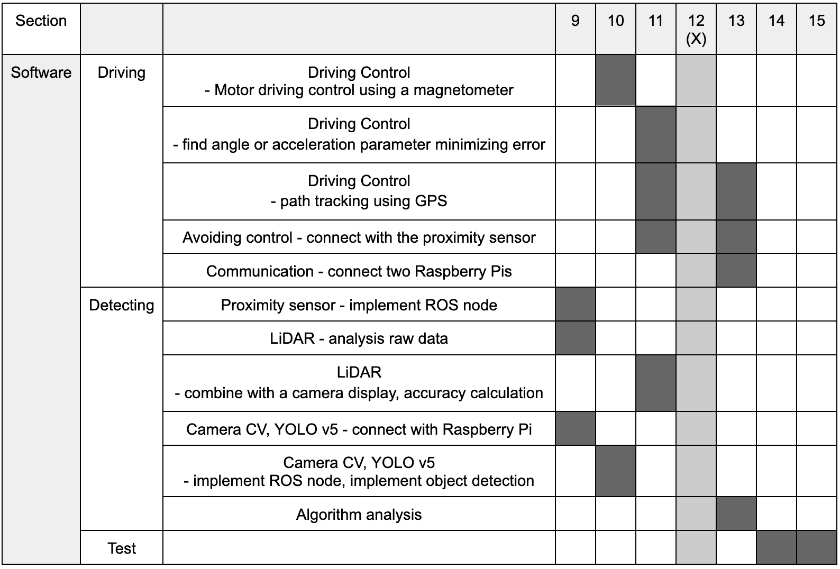
Future Plan
Robot (SW)

Slide 22
References
[1] H. Regan. "World will have 710M tons of plastic pollution by 2040 despite efforts to cut waste, study says." CNN.com. \url{https://www.cnn.com/2020/07/23/world/plastic-pollution-2040-study-intl-hnk/index.html} (accessed Sept. 27, 2022).
[2] P. HOARE, "Broken glass proving the scourge of Cork's beaches," Irish Examiner, Aug. 2021. Accessed: Sept. 26, 2022. [Online]. Available: \url{https://www.irishexaminer.com/news/munster/arid-40353995.html}
[3] A. PaulKrelling, A. Thomas, and A. Turra, “Differences in perception and reaction of tourist groups to beach marine debris that can influence a loss of tourism revenue in coastal areas,” Marine Policy, vol. 85, pp. 87-99, Nov. 2017, doi: \url{https://doi.org/10.1016/j.marpol.2017.08.021}
[4] P. Mebly and T. Cathcart, “Experimental Beach Landscape 12 Year Study Results,” Amer. Soc. of Landscape Architects, New York, United States of America, 2007. [Online]. Available: \url{https://citeseerx.ist.psu.edu/viewdoc/download?doi=10.1.1.553.8469&rep=rep1&type=pdf}
[5] H. Barber \& Sons, Inc. "BEACH CLEANING MACHINES." BARBER. \url{https://www.hbarber.com/beach-cleaning-machines} (accessed Sep. 27, 2022).
[6] SCAM. "Beach Cleaners." SCAM. \url{http://www.beach-cleaning-machine.com/products} (accessed Sep. 27, 2022).
[7] 4OCEAN. "4ocean x Poralu BeBot." 4OCEAN. \url{https://www.4ocean.com/pages/4ocean-x-poralu-bebot} (accessed Sep. 22, 2022).
[8] V. Dhoe, O. Doke, A. Kakade, S. Teradale, and R. Patil, "DESIGN AND FABRICATION OF BEACH CLEANING MACHINE," \emph{Int. Res. J. of Eng. and Technol. (IRJET)}, vol. 6, no. 4, pp. 796-800, Apr. 2019. [Online]. Available: \url{https://www.irjet.net/archives/V6/i4/IRJET-V6I4175.pdf}
[9] C. Balasuthagar, D. Shanmugam, and K. Veshwaran, "Design and fabrication of beach cleaning machine," in \emph{3rd Int. Conf. on Advances in Mech. Eng. (ICAME 2020)}, in Design, in IOP Conf. Series: Mater. Sci. and Eng., vol. 912, 2020, pp. 1-5, doi: \url{10.1088/1757-899X/912/2/022048}.
[10] S. Watanasophon and S. Ouitrakul, "Garbage Collection Robot on the Beach using Wireless Communications," in \emph{2014 3rd Int. Conf. on Inform., Environ., Energy and Appl. (IEEA).}, Singapore, 2014, pp. 92-96, doi: \url{10.7763/IPCBEE. 2014. V66. 19}.
[11] N. Bano et al., "Radio Controlled Beach Cleaning Bot," \emph{2019 IEEE 6th Int. Conf. on Eng. Technologies and Applied Sci. (ICETAS).}, 2019, pp. 1-6, doi: \url{10.1109/ICETAS48360.2019.9117269}.
[12] J. Shelke, B. Bhakare, K. Lute, A. Pateshwari, and H. Khodiyar, "BEACH CLEANING SYSTEM \& SURFACE CLEANING SYSTEM," \emph{Int. Res. J. of Modernization in Eng. Technol. and Sci. (IRJMETS)}, vol. 2, no. 6, pp. 103-108, June. 2020. [Online]. Available: \url{https://www.irjmets.com/uploadedfiles/paper/volume2/issue_6_june_2020/1458/1628083036.pdf} % Periodicals Online
[13] O. Cieza, C. Ugarte, E. Gutiérrez, J. García, and J.Tafur. "Prometeo: Beach Cleaner Robot" Sistema Olimpo. [Online]. Available: \url{http://www.sistemaolimpo.org/midias/uploads/d7abd08b1e341fcd029c5ca0e3ca2218.pdf}
[14] R. G. Apaza, E. G. Linares, E. A. Soto Mendoza, E. D. Supo Colquehuanca. (2013). HS-GreenFist: Beach Cleaner RobotTeam Description Paper. LARC 2013. IEEE Open Category. [Online]. Available: \url{http://www.natalnet.br/lars2013/LARC/Artigo18.pdf}
[15] F. S. da Roza, V. G. da Silva, P. J. Pereira, and D. W. Bertol, "Modular robot used as a beach cleaner," (in Spanish), \emph{Ingeniare. Revista chilena de ingeniería}, vol. 24, no. 4, pp. 643-653, Dec. 2015, doi: \url{10.4067/S0718-33052016000400009}.
[16] J. S. Priya, K. T. Balaji, S. Thangappan, and G. Y. Sudhakaran, "Beach Cleaning Bot Based On Region Monitoring," in \emph{2019 Int. Conf. on Computation of Power, Energy, Inf. and Communication (ICCPEIC).}, 2019, pp. 257-260, doi: \url{10.1109/ICCPEIC45300.2019.9082368}.
[17] T. Ichimura and S. Nakajima, "Development of an autonomous beach cleaning robot “Hirottaro”," in \emph{2016 IEEE Int. Conf. on Mechatronics and Automat..}, Harbin, China, 2016, pp. 868-872, doi: \url{10.1109/ICMA.2016.7558676}
[18] T. Ichimura and S. Nakajima, "Performance Evaluation of a Beach Cleaning Robot “Hirottaro 3” in an Actual Working Environment," in \emph{2018 18th Int. Conf. on Control, Automat. and Syst. (ICCAS 2018).}, PyeongChang, Gangwon, Korea, 2018, pp. 825-828.

Slide 23
Q&A | Thank you
Eunmin Kim, Jeeyoung Oh, Seoyeong Lee, Booyong Kim, Hanbyeol Lee, Caleb Ikalina
Team C.C
K-SW 2022 Fall Program
kim4153@purdue.edu, oh310@purdue.edu, lee4490@purdue.edu, kim4162@purdue.edu, lee4487@purdue.edu, c.lialina@purdue.edu

